Slide 1

The updated PDU system and how to register PDUs

Slide 2
Content
Update to the PDU system – Overview
Update to the PDU system – Categories
Report PDU – Step 1 to 4
Renew certification

Slide 3
Update to the PDU system - Overview
PDU Category Structure has been update
Since research has shown that people did not fully understand the PDU categories and how to appropriately report their PDUs. An updated category structure was implemented on 1 March 2011.
Overview of changes to the PDU category structure for your information:
Category structure has been simplified, thereby reducing the number of categories from 18 to 6
All categories use the rule that one hour of learning activity is equivalent to one PDU
There will be limits on certain categories to require that all credential holders pursue project management continuing education as part of maintaining their credential
It is also important to note what is NOT changing in the program:
The three-year renewal cycle and number of PDUs required to maintain the credential will remain the same
The re-certification fee structure will remain the same

Slide 4
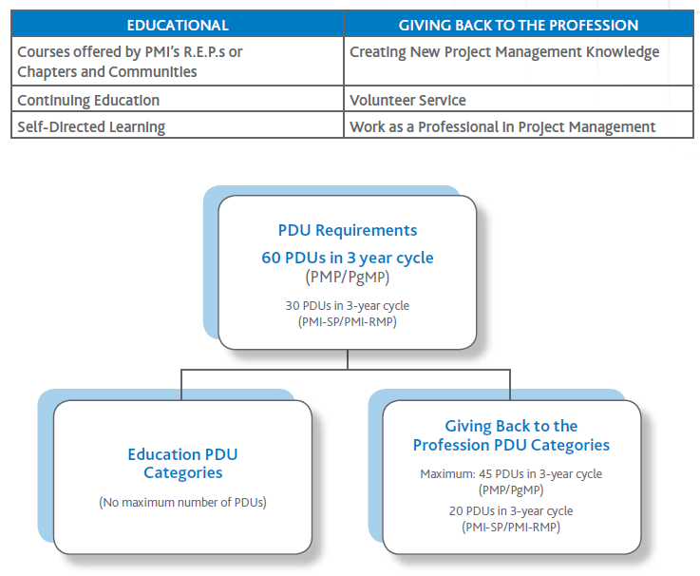
Update to the PDU system - Categories
Each professional development activity yields one PDU for one hour spent engaged in the activity. The new six PDU categories fall into two divisions—Education and Giving Back to the Profession—as illustrated below.

Slide 5
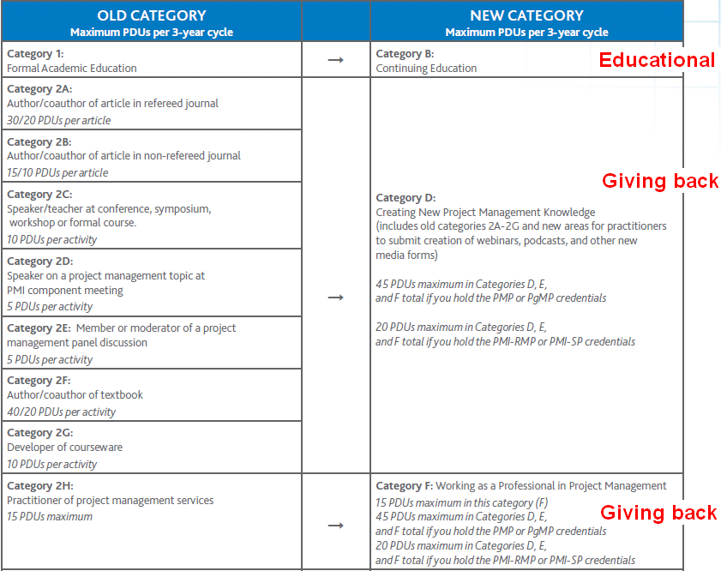
Update to the PDU system - Categories

Slide 6
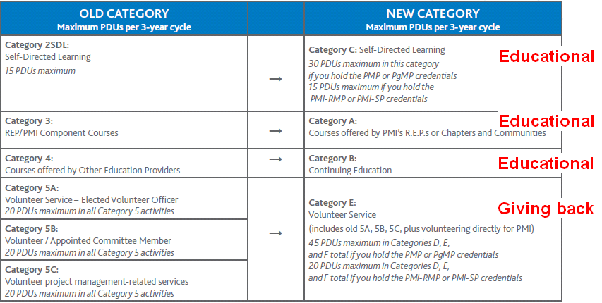
Update to the PDU system - Categories

Slide 7
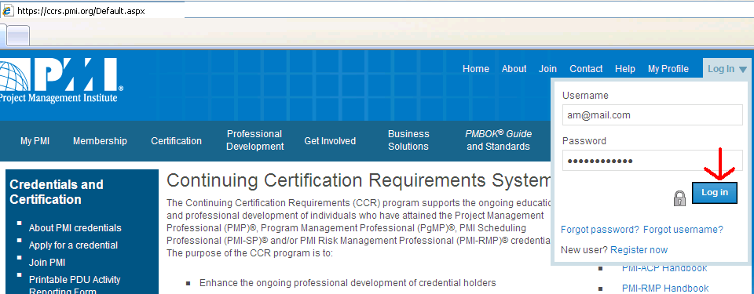
Report PDU step 1: Login
Go to https://ccrs.pmi.org/ and log in with your PMI user name and password
Select "View My PDU Activity” or “Report professional development units (PDUs)."

Slide 8
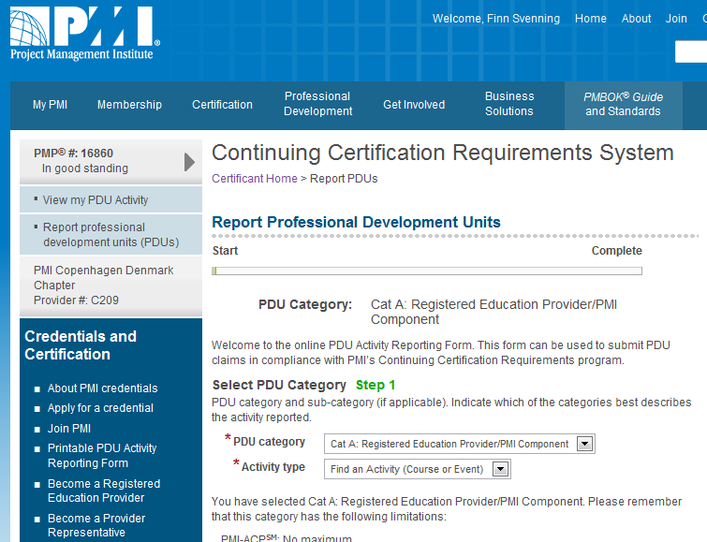
Report PDU step 2: Reporting
Select “PDU category” and “Activity type"

Slide 9
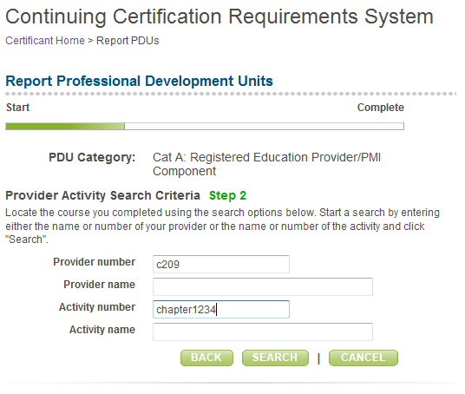
Report PDU step 3: Find Activity
Enter “Provider number” and Search for all activities or enter “Activity number" ex. ‘chapter1234’ for regular chapter meeting or 290311konf for the annual conference held i March 2011.

Slide 10
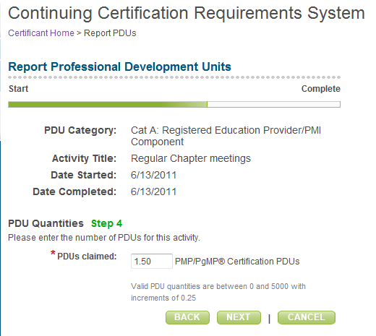
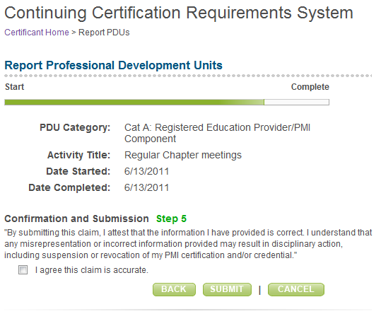
Report PDU step 4: Finish Registration

Slide 11
Renew certification
You can renew your certification if you have the required PDUs by clicking on the “Renew a Certification” button on the page.

